Slide 1
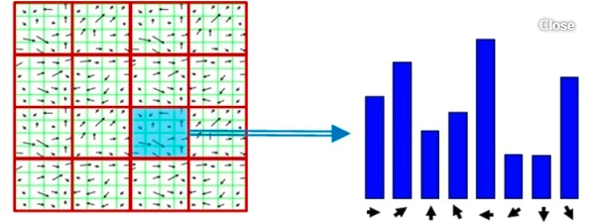
Histogram of Oriented Gradients
Feature Descriptor

Slide 2
Feature Descriptor
A feature descriptor is a representation of an image or an image patch that simplifies the image by extracting useful information and throwing away extraneous information.
Histogram of Oriented Gradients
Histogram of oriented gradients (HOG) is a feature descriptor used to detect objects in computer vision and image processing.
The HOG descriptor technique counts occurrences of gradient orientation in localized portions of an image - detection window, or region of interest (ROI).
Essentially represents a distribution of intensity fluctuations along different orientations (directions)

Slide 3
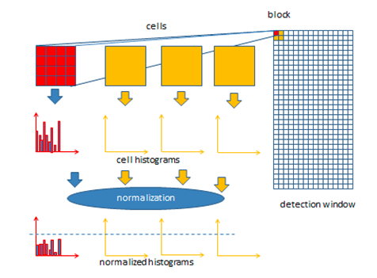
Steps to calculate HOG
Preprocessing(resizing)
Divide into cells/blocks
2. Calculate Gradient Images
3. Calculate Histogram of Gradients in 8×8 cells
4. Block Normalization
5. Form HOG feature vector

Slide 4
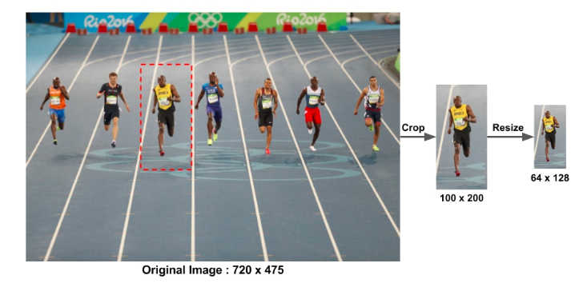
Step 1 - Pre-Processing
Patches being analyzed should have a fixed aspect ratio.
For example, they can be 100×200, 128×256, or 1000×2000 but not 101×205.

Slide 5
Step 2 - Divide into Cells/blocks
Cell: 8x8 pixels (or 4x4 pixels)
Block: 2x2 cells
50% overlap for neighbors.
E.g., for a 64 x 128 image:
Since blocks are 50% overlapped,
7x15=105 blocks in total and each block consists of 2x2 cells with size 8x8

Slide 6
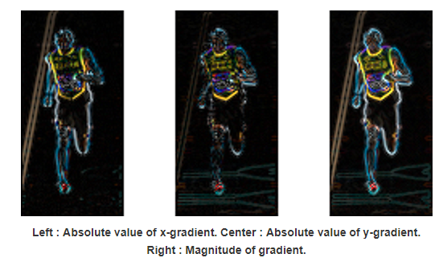
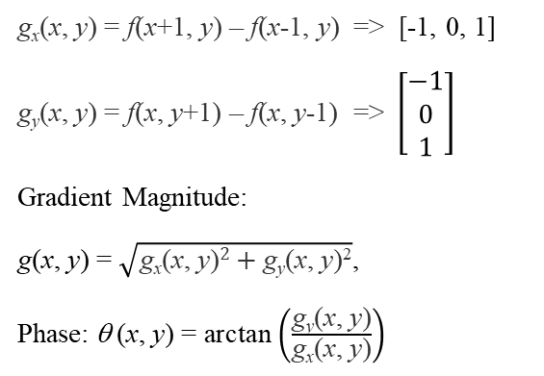

Step 3 - Calculate Gradient Images
For each pixel within a cell, the horizontal and vertical gradients are obtained. We use 1-D centered, point discrete derivative (Sobel masks) for horizontal and vertical gradients, respectively:
g_{x}(x, y) = f(x+1, y) – f(x-1, y) => [-1, 0, 1]
g_{y}(x, y) = f(x, y+1) – f(x, y-1) =>$\left[\begin{matrix}−1 \\ 0 \\ 1\end{matrix}\right]$
Gradient Magnitude:
$\text{g}\text{(}\text{x}\text{, }\text{y}\text{) =} \sqrt{\text{g}\text{x}\text{(}\text{x}\text{, }\text{y}\text{)}2+\text{g}\text{y}\text{(}\text{x}\text{, }\text{y}\text{)}\text{2}}$,
Phase:$\text{} \text{(}\text{x}\text{,} \text{y}\text{) =} \text{arctan}\left(\frac{\text{g}\text{y}\text{(}\text{x}\text{, }\text{y}\text{)}}{\text{g}\text{x}\text{(}\text{x}\text{, }\text{y}\text{)}}\right)$
g
g_{y}
$$\text{}$$
g_{x}

Slide 7
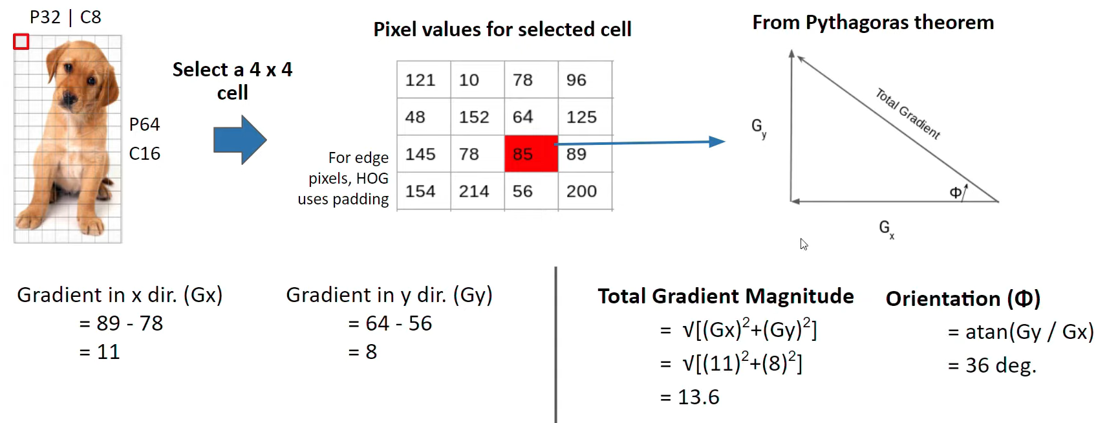
Calculate Gradient Images (contd.)

Slide 8
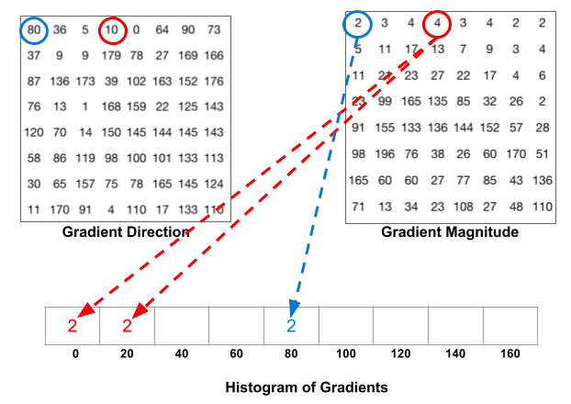
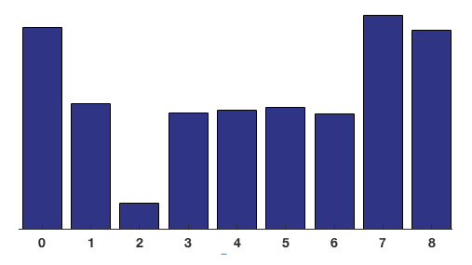
Step 4 - Calculate Histogram of Gradients in each cell
The gradient of each pixel in an 8×8 cell contains 2 values (magnitude and direction), which sums up to 8x8x2 = 128 numbers.
Next, we divide the gradients into 9 bins and compute the amount of gradient magnitude in each bin.
This results in 1x9 feature vector for 1 cell, and each block contains 4 cells, so total 1x36 features for 1 block.

Slide 9
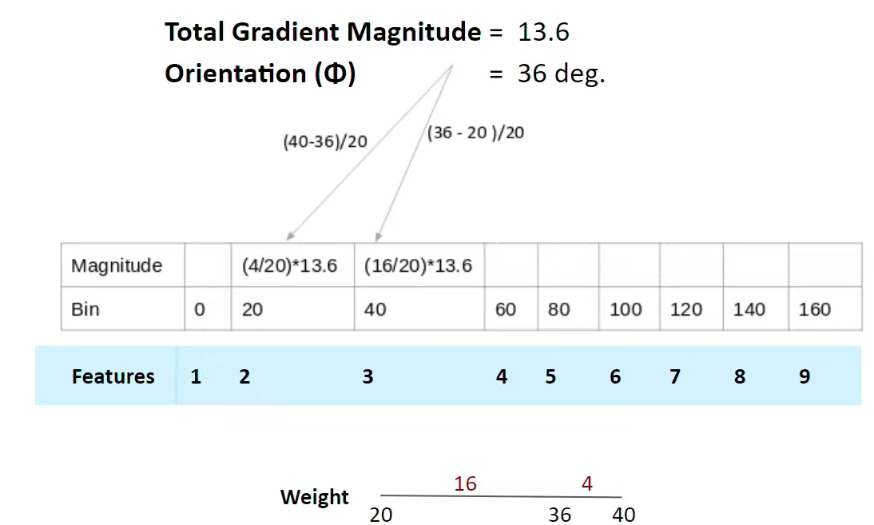
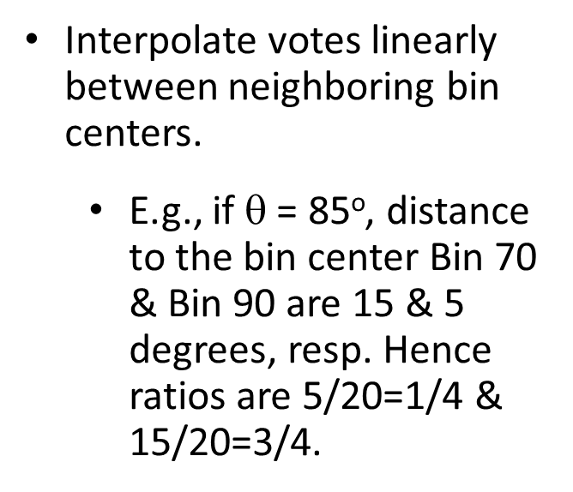
Calculate Histogram of Gradients in 8×8 cells
Example
Interpolate votes linearly between neighboring bin centers.
E.g., if $\text{}$ = 85º, distance to the bin center Bin 70 & Bin 90 are 15 & 5 degrees, resp. Hence ratios are 5/20=1/4 & 15/20=3/4.

Slide 10
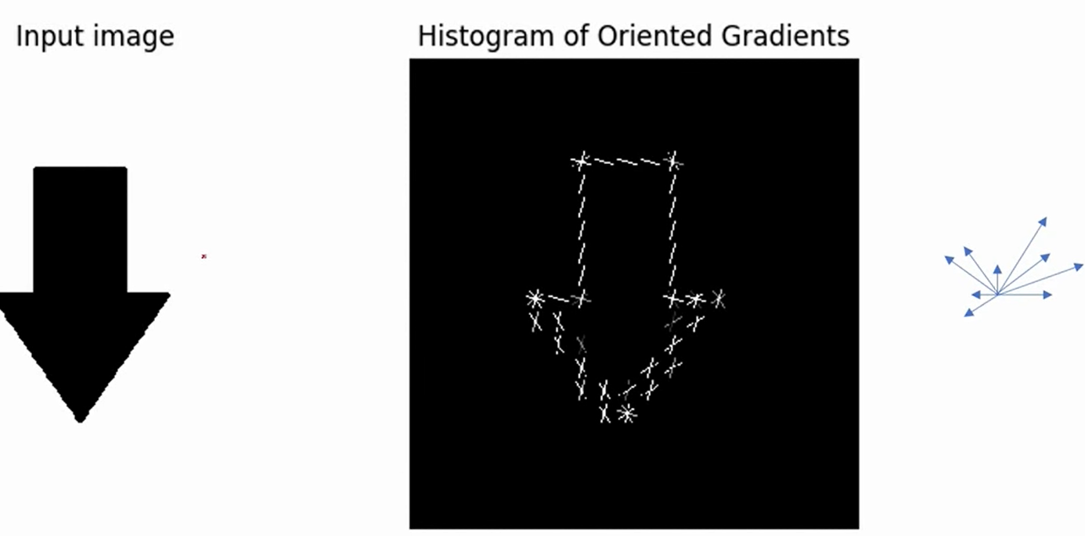
HOG – Example
In HOG, it is common to represent the histogram of gradients of each cell in a compact form as shown in the example below.
Each vector represents the total magnitude of a bin in a certain orientation (angle).
…
40
20
0
160
A compact pictorial representation of Gradients

Slide 11
HOG – Example
In HOG, it is common to represent each cell in a compact form as shown in the example below.
Each vector represents the total magnitude of a bin in a certain orientation (angle).
…
40
20
160
0
A compact pictorial representation of Gradients

Slide 12
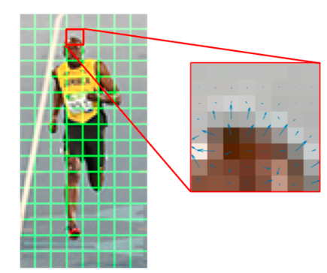
Computing gradients of a color image
For color images, the gradients of the three channels are evaluated.
The magnitude of gradient at a pixel is the maximum of the magnitude of gradients of the three channels, and
the angle is the angle corresponding to the maximum gradient.

Slide 13
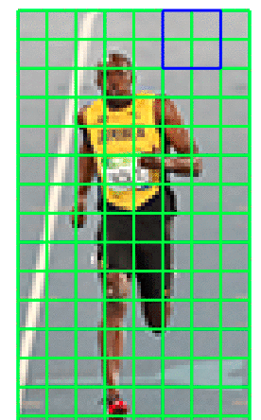
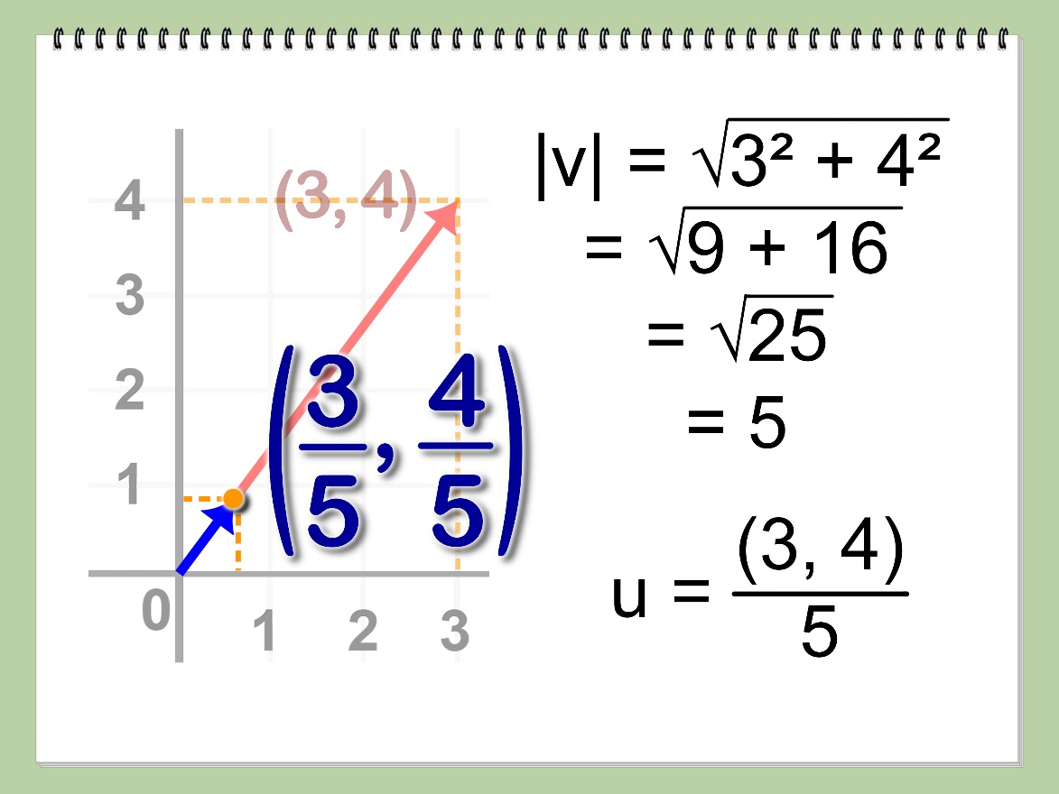
Step 5 - Block Normalization
Imagine 2 same cells, that only differ in brightness
HOG will compute very different histograms for these 2 cells.
Solution: Normalize the histogram so that they are not affected by lighting variations.

Slide 14
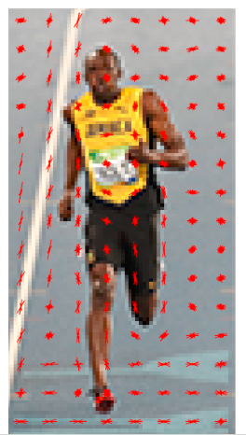
Step 6 - Create the HOG feature vector
To calculate the final feature vector for the entire image patch, the 36×1 vectors are concatenated into one giant vector
8-1 = 7 blocks
How many positions of the 16×16 blocks do we have ? There are 7 horizontal and 15 vertical positions making a total of 7 x 15 = 105 positions.
Each 16×16 block is represented by a 36×1 vector. So when we concatenate them all into one gaint vector we obtain a 36×105 = 3780 dimensional vector.
16-1 = 15 blocks

Slide 15
Cons of HOG
Computation speed of HOG is tardy while detecting an object for large-scaled images as it uses a sliding window technique to extract features from every pixel of an image.
HOG is not scale-invariant. Getting the same length feature vector for each image does not guarantee the scale invariance.
A HOG is not a rotation invariant. Therefore, when used in object detection tasks, it can only handle objects that are observed at a certain orientation.

